Slide 1

DEPARTMENT OF COMPUTER SCIENCE AND ENGINEERING
Title: AI-Based Multilingual Speech and Text Translation System
Using Whisper ASR with CNN-BiLSTM Emotion Awareness
BATCH ID : 23MPCS-H23
S. No | Roll. No | Student Name
1 | 23881A05EY | B.Nikhil
2 | 23881A05FF | G.Sai Harshitha
3 | 23881A05FQ | K.Shiva sai
Guide Details
Ms. Pallikonda Kaveri
Assistant Professor
Department of CSE

Slide 2
Mini Project Outlines
Introduction
Existing System Vs Proposed
Research Gaps
Problem Statement
Proposed Project Objectives
Proposed Project Outcomes
Software and Hardware Requirements
Architectural Diagram
Proposed Methods and Algorithms
Results
Research Paper (Acceptance Proofs)
Conclusion

Slide 3
Introduction
Communication across different languages is a major challenge in today’s global world
Existing systems mainly focus on translation without considering user emotions
This leads to unnatural and robotic communication
Emotion-aware systems can improve interaction quality
This project proposes an integrated system combining translation and emotion detection

Slide 4
Existing System Vs Proposed
Feature | Existing System | Proposed System
Translation Approach | Basic text/speech translation | Context-aware translation with emotion
Speech Output | Neutral Text-to-Speech | Emotion-aware expressive speech
Real-Time Performance | Moderate latency | Optimized real-time processing
Multilingual Support | Limited support | Scalable multilingual system
User Interaction | Robotic and less natural | Human-like and empathetic
System Integration | Separate modules | Unified intelligent system
Feature | Existing System ❌ | Proposed System ✅
Translation Approach | Basic text/speech translation | Context-aware translation with emotion
Speech Output | Neutral Text-to-Speech | Emotion-aware expressive speech
Real-Time Performance | Moderate latency | Optimized real-time processing
Multilingual Support | Limited support | Scalable multilingual system
User Interaction | Robotic and less natural | Human-like and empathetic
System Integration | Separate modules | Unified intelligent system
DEPARTMENT OF CSE : MINI PROJECT

Slide 5
Research Gaps
Lack of systems combining translation and emotion detection
Limited accuracy in noisy environments
Poor handling of real-time communication
Lack of support for multiple languages simultaneously
Absence of unified system architecture
DEPARTMENT OF CSE : MINI PROJECT

Slide 6
Problem Statement
Current systems fail to capture emotional tone of users
This results in loss of meaning during communication
There is a need for a system that:
Understands speech/text
Detects emotion
Produces meaningful responses
Aim: Improve natural human-machine
DEPARTMENT OF CSE : MINI PROJECT

Slide 7
Proposed Project Objectives
Develop a multilingual translation system
Implement speech-to-text using Whisper ASR
Detect emotions using deep learning models (CNN-BiLSTM)
Generate expressive speech output
Ensure real-time performance
Improve user interaction quality
DEPARTMENT OF CSE : MINI PROJECT

Slide 8
Proposed Project Outcomes
Accurate conversion of speech to text
Context-aware translation
Emotion classification (Happy, Sad, Angry, Neutral)
Natural and human-like responses
Improved communication efficiency
DEPARTMENT OF CSE : MINI PROJECT

Slide 9
Software and Hardware Requirements
Software:
Python
TensorFlow
Whisper API
NLP Libraries
Hardware:
Laptop
Microphone
Internet connection
DEPARTMENT OF CSE : MINI PROJECT

Slide 10
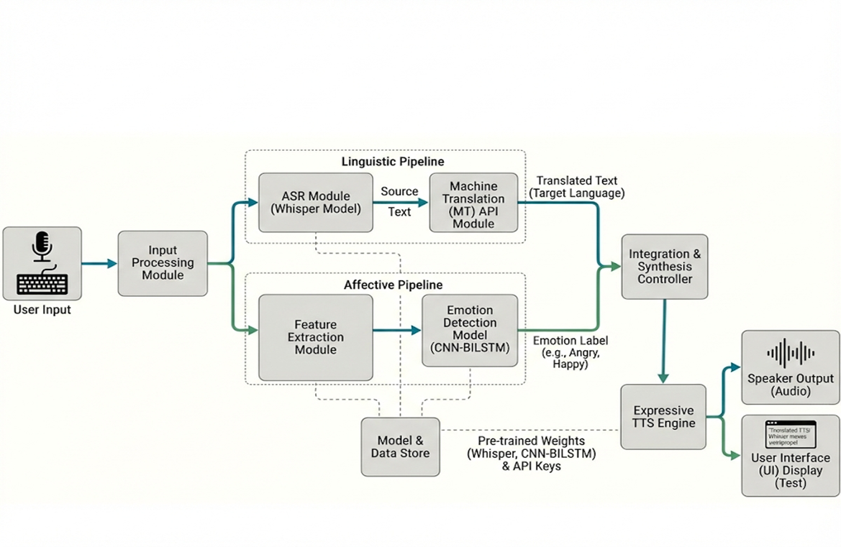
Architectural Diagram
DEPARTMENT OF CSE : MINI PROJECT

Slide 11
PROPOSED METHOD AND ALGORITHMS
Whisper ASR: Converts speech into text
Text Preprocessing: Cleans and normalizes input
Neural Machine Translation: Translates text into target language
CNN-BiLSTM Model: Detects emotions from text
Text-to-Speech (TTS): Generates voice output
DEPARTMENT OF CSE : MINI PROJECT
DEPARTMENT OF CSE : MINI PROJECT

Slide 12
Results
The system successfully converts speech to text with high accuracy
Multilingual translation preserves the meaning and context of input
Emotion detection correctly identifies basic emotions (happy, sad, angry, neutral)
The system generates emotion-aware speech output
Achieves real-time performance suitable for practical applications
Feature | Result
Speech Recognition | High Accuracy
Translation | Context Preserved
Emotion Detection | Accurate
Response Time | Fast
Feature | Result
Speech Recognition | High Accuracy
Translation | Context Preserved
Emotion Detection | Accurate
Response Time | Fast
DEPARTMENT OF CSE : MINI PROJECT

Slide 13
Research Paper (Acceptance Proof)
DEPARTMENT OF CSE : MINI PROJECT
DEPARTMENT OF CSE : MINI PROJECT

Slide 14
Conclusion
The proposed system successfully integrates multilingual translation with emotion detection
It improves communication by providing context-aware and meaningful responses
The system generates emotion-aware speech output, making interaction more natural
Real-time processing enhances usability in practical applications
Overall, the system offers a more intelligent and human-like communication experience
DEPARTMENT OF CSE : MINI PROJECT

Slide 15
Thank You
DEPARTMENT OF CSE : MINI PROJECT

